Slide 1
ISIS/Mantid intro and least squares with the SCD Numerical Group
Anders Markvardsen
ISIS
April 2015

Slide 2
Contacts
Main point of contact
Mantid team in general
Groups and individuals with least squares problems at ISIS

Slide 3
Today
Preliminary short Mantid intro
Mantid fitting
Examples of medium to long term projects
Discussions of what next before and after 1st Oct

Slide 4
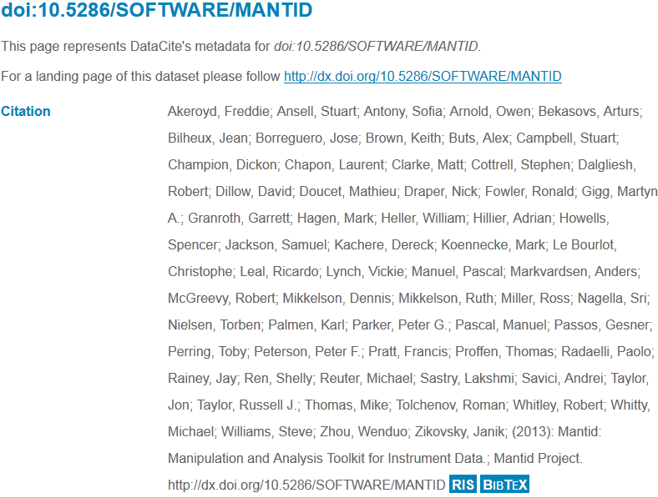
Project contributors

Slide 5

Project Goals
Goals
Consolidate the data reduction/analysis software for neutron/muon scattering without restricting the needs of the instrument scientists
Key requirement
Create a data reduction/analysis framework
not instrument or technique/dependent
Cross-platform
Windows, Linux, Mac
Easily extensible
Freely redistributable

Slide 6
Design Criteria
Separation of Data and Algorithms
Encapsulated “User Code” in specific places
Algorithms
Workspaces
Use of interfaces to allow generic use of components
Reuse of existing components
Careful memory management when handling large datasets

Slide 7

Architectural Design - Overview
Instrument log files
Python
Command line & Scripting interface
Mantid Framework
RAW data files
API
Algorithms
Workspaces
MantidPlot Graphing and analysis
NEXUS data files
User Defined
User Defined
DAE direct access
Future Instrument specific UI
Future Instrument specific UI

Slide 8
Plug in extensions
Algorithm Dialogs Custom Interfaces Custom Menus
Algorithms
Unit Conversions
Fit Functions Cost Models Constraints Minimizer
Workspaces
Archive Searching LiveData Listeners Data Catalogs
GUI
Framework
(Framework) Utility

Slide 9
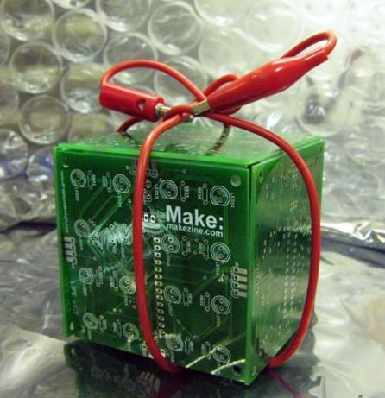
Open Source
GPL v3
Free to use
Source code openly available
Good basis for collaboration
Sharing benefits to wider community

Slide 10
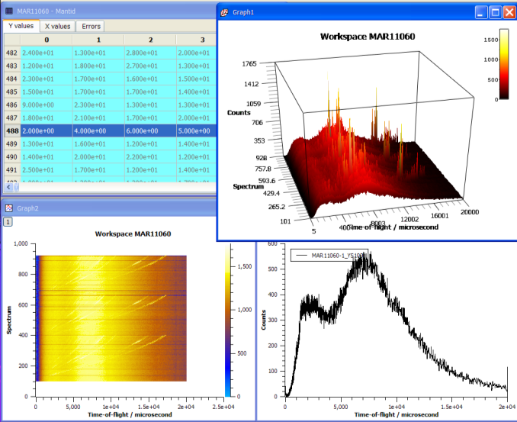
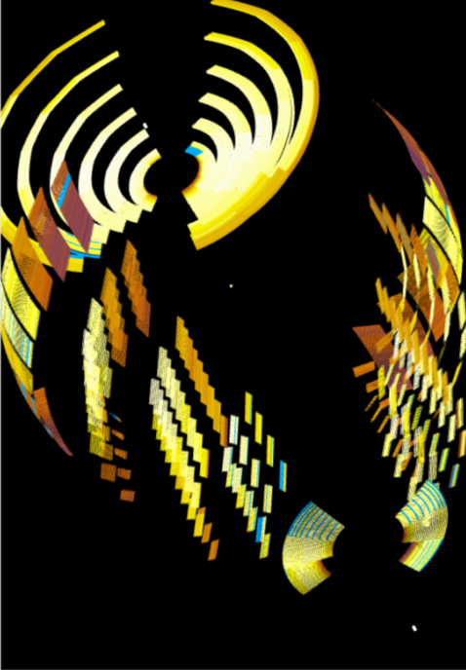
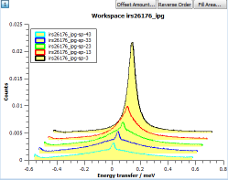
What can we do - Visualization

Slide 11
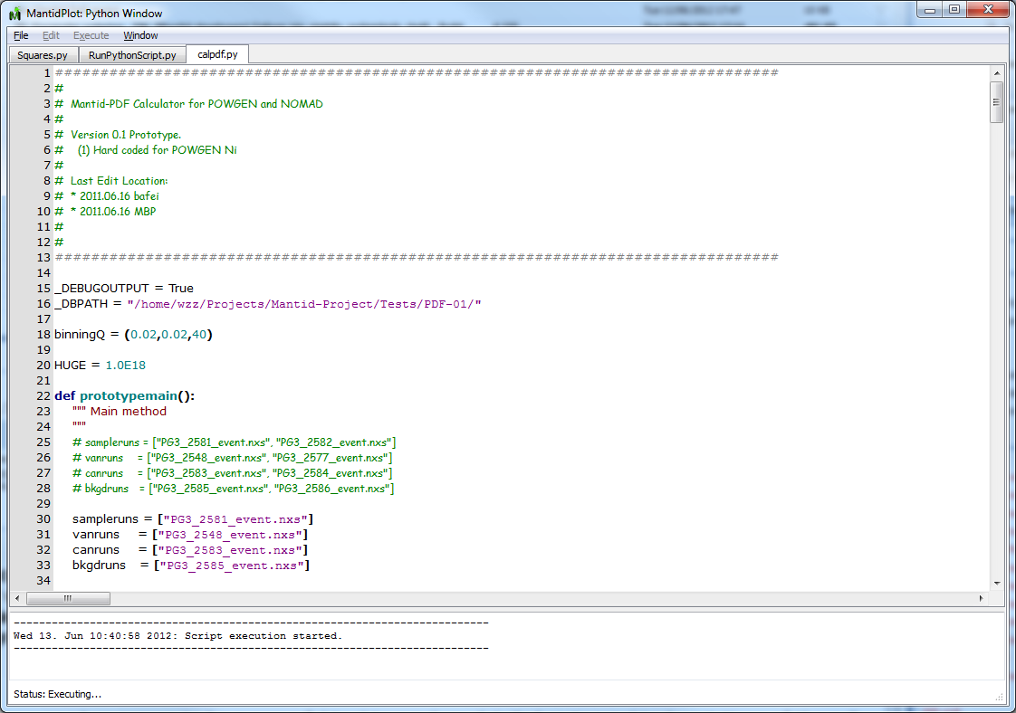
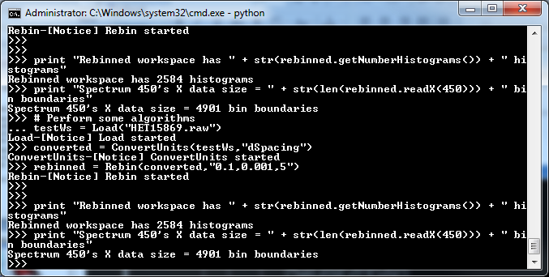
What we can do - Scripting
Python Control
Within Mantidplot
Pure Python scripts
Integrated numPy
Automated reduction

Slide 12
What we can do - Algorithms
~600
Arithmetic
Correction Functions
Absorption
Background
Efficiency
Technique
Single Crystal
Inelastic
SANS
Powder diffraction
Data handling
Diagnostics
Event Filtering
Optimization
Transforms
Masking
Grouping
Smoothing
Unit conversions

Slide 13
Mantid Fitting
Fit Functions Cost Models Constraints Minimizer
Algorithm
Fit
<<use>>
<<use>>
<<use>>
<<use>>
IFunction
ICostFunction
IConstraint
IFuncMinimizer
Gaussian
BoundaryConstraint
CostFuncLeastSquares
LevenbergMarquardt
<<use>>
GSL

Slide 14
Medium to long term projects
Research oriented
Maximises the benefit of input from the numerical group and the benefit for ISIS
Potentially very high medium to long term impact for ISIS

Slide 15
General upgrade to Mantid least squares speed and stability
Fit Functions Cost Models Constraints Minimizer
Goal: Replace old mediocre LS engine with state of the art LS engine
Motivations:
Instant benefit to all existing fitting activities in Mantid
Expose state of art LS engine to the neutron scattering community
Work:
Benchmarking (including using existing system and unit tests)
Updates to Mantid LS (perhaps not all in one go)
Advertise and use is

Slide 16
More to least squares than finding the nearest local minimum
Global optimisation question
Hitting rate frequency of local minima
(e.g. 100 #1, 110 #1000, 120 #1)
Finding transition states between competing local minima
Estimating other LS cost function properties

Slide 17
Engineering example
A point of contact: Joe Kelleher (EnginX principle beamline scientist)
NMUM 2014 breakout engineering session
Keywords from Joe Kelleher
Wrong physical answer
Failure to converge
Avoiding false minimum – global optimisation
Happy to provide examples
[Also other optimisation problems…!]

Slide 18
Further opportunities for training
Mantid training courses (next in Sep/Oct)
Training material on the web (Quick Start Guide)
Half/full day specialised training

Slide 19
Timeline
Before 1st Oct suggestion:
Training
Provide least squares examples
Monthly communications?
Diamond?
Other?
After 1st Oct: (annually reviewed)
Meeting monthly
Provide further least squares examples
Bug support
Any further training
Interface support
Help with testing an integration
One software scientist 2 days per month

